Slide 1

DLM update
Zoltán Szatucsek – DLM Forum, National Archives of Hungary
17th meeting of European Archives Group, Turin, 03.11.2014

Slide 2
Short introduction
AIIM
ARMA
Austrian State Archives
Automated Intelligence
Autonomy HP
Bundesarchiv
Croatian National Archives
Danish National Archives
Dansk Scanning
Direzione Generale per gli Archivi
EMC
Estonian Ministry of Economic Affairs
Estonian National Archives
European Central Bank
Fabasoft
Finnish Business Archives Association
Finnish Municipal Records Management Association
Finnish National Archives
French National Archives
Gimmal
Gordic
HATII, University of Glasgow
INESC-ID, University of Lisbon
InForm Consult
Kovex
LDP Centre, LULEA University
Lithuanian State Enterprise Centre of Registrars
Mikkeli University of Applied Sciences
Naczeina Dyrekcja Archiwow
National Archives of Hungary
National Archives of Ireland
National Archives of Latvia
National Archives of Malta
National Archives of Norway
National Archives of Romania
National Archives of Slovenia
National Archives of Spain
National Archives of Sweden
National Archives of the Netherlands
National Records of Scotland
Objective Corporation
OpenText
University of Portsmouth
RSD
Russian Records Management Guild
The National Archives (UK)
Tessella

Slide 3

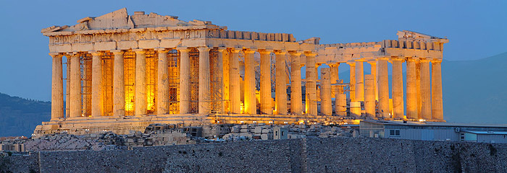
since June
since Athens
new office bearers
infrastructure
financial stability
secreteriat
professional programme
Moreq
E-ARK
Triennial conference, Lisbon
Notes:
There are new faces around the table
Very short introduction
Athens celebration
We are not only celebrated, but worked in Athens
An exceptionally good composition of the EC
RSD, GIMMAL, PRESERVICA, SP
MECD, ARS, NAH,
IST, UPHEC
Now DLM management is very well representedn, with a good balance of companies
In Copenhagen we
There are ups and downs and we
Information Governance
There are
Knowledge exchange which field? Digital archives
For this E-ARK is an extremely iportant instrument

Slide 4

Moreq
2010 was four years ago
good time to move ahead teaming up with E-ARK
missing modules – archival transfer
Notes:
MoReq 2010 was initially published as a standard in 2010, but the process of creating the test scripts to certify vendors against the standard was never quite finalized. As a result, after four years, there have been no vendors certified and there is no current path to completion. Additionally, there have been several market and technology developments in the last few years. The authors volunteered to solicit opinions and volunteers and develop an approach to resuscitate the MoReq 2010 standards and certification process for the DLM Forum.

Slide 5

E-ARK
Best practice overview – August, 2014
General model – August, 2014
Knowledge centre service PoC – February, 2015
First versions of pan-european E-ARK formats SIP/AIP/DIP – May, 2015 with a February draft.
Notes:
General introduction
Second phase
In August, the preliminary phase was over, and the between M7 and M15, September and next May the most intensive period with the most important products is coming
SIP/AIP/DIP first draft next February, May final and August we publish the first tools use the new specifications.
A couple of words about these products.

Slide 6

SIP – easy ingest to archives
analysis of existing SIPs (Sweden, Denmark, Estonia, Hungary), mapping the metadata sets and metadata elements
formulate requirements (validation, capacity, extendability, simplicity)
Moreq integration (further development of Moreq disposal and export services)
Notes:
The most painful part for the archives, because record creators tend to transfer records in diverse way, with poor metadata, breaching the regulations, and archives feel responsibility even for the badly prepared records.
This is the area what the archives struggling with the most.
The aim is EARK SIP related activity IS to design a structure which is simple enough and undersandable for major archives’ digital archives systems.
activities:
analysis of existing SIPs
formulate requirements
moreq integration
first draft specification, final specification next May

Slide 7
DIP – how can we produce an IP for users
Need for a free‐text search across metadata elements via one search field i.e. “Google Search” on metadata about Information Packages
Need for a search via browsing a hierarchy
Need for access to comprehensive metadata about Information Packages in Finding Aids
Need for access to DIPs without the use of presentation tools, e.g. delivered on a portable medium
Need for an advanced search
Need for continuous access to old records without having to go through the request process each time records are accessed (this need is specific to Producers)
Need for easy access to Finding Aids
Need for free-text search on content in an Information Package via one search field i.e. a “Google Search” on the content
Need for more than one way of searching in Finding Aids
Need for online access to DIPs via presentation tools
Need for support of data mining
Need for the integration of viewing tools in presentation tools, e.g. a document viewer or video viewer
Need for user‐friendly and meaningful presentation of search results
Need to export and reuse data and/or subsets of data in external tools e.g. MS Word, MS Excel, statistical analysis packages
Need to print out metadata, digital documents and records from within Information Packages
Need to relate content to Representation Information while viewing and using content
Need to search across Information Packages using variables, e.g. to identify those containing social security numbers
Need to search on metadata elements within one Information Package
Need to search on the content of digital documents within Information Packages
Need to search on values across different Information Packages, e.g. search on a specific social security number
(D)IP
Container
Metadata
Data
Environment
requirements (environment, container, metadata, data, format)
standards (METS, PREMIS, MIX, GML, SIARD, DC, CIDOC-CRM, apeEAD, EDM)
workflow steps (filter, watermark, index, transform)
Notes:
There are different forms how archives produce data for users
delivery records for individual users,
mass records for aggregator services, like APEX
transfer for external services – like CENDARI
Archives use now their own systems to export and use additional tools to transform data to the target system designed for final use.
DIP design is to provide a general interface the archive systems with delivery systems.
activities:
requirements (examples)
standards,
workflows
Deadlines are the same

Slide 8

If we use the same structure...
it gives exact requirements those who hadn’t have before
speaking same language leaves us to focus on more specific problems and fields
using same tools for digital archiving and representations (like DPT)
Notes:
Advanteges...
exact requirements,
lingua franca
tool recycling
bigger market
...and limits...
there are 5 national archives involved in the project NAE, NAN, DNA, ARS, NAH
but...
further archives are in the advisory board TNA, France, NANETH and all others are more than welcome,
almost each member states can follow the developments through DLM
we cannot expect that EARK format will be generally used as an exclusive method of archival transfer and delivery, but an inavoidable and important step to harmonize the business processes of the archives.

Slide 9

Advisory Board meetings
iPres 2014, 6-10 October, Melbourne, Australia (see http://ipres2014.org/). The E-ARK AB session was held on Thursday 9 October,
2nd Annual Conference of ICA, 13-15 October, Girona, Spain (see http://www.girona.cat/web/ica2014/eng/). The E-ARK AB session was held on Tuesday 14 October,
DLM Forum Triennial Conference, 12-14 November, Lisbon, Portugal (see http://dlmlisbon2014.dlmforum.eu/). The E-ARK Advisory Board meeting will be held on Friday 14 November, from 1330 – 1730, with a 30 minute coffee break about 1500.
Notes:
AB meetings
Three Abs are exists
archivists
technical
governement
In the project there is a renewal discussion whether is realistic to provide a common standard to 28 member states and thousands of institutions.
Seeing the first concrete steps I am optimistic, we have found a common ground for the pan-european SIP. And it will be usable and working solution for a series of countries and we can make refinements later. Meanwhile it is very important to participate actively in the development, react to the concept and first drafts will be available in the following month, early next year.
Public events
Apart from AB meetings there are public events for advertizing the outcomes.
Major events are DLM MM first in Athens, then Lisbon, next year in Riga.
That is about E-ARK. But public events lead us to the next topic. Lisbon is not only about E-ARK

Slide 10

Lisbon Triennial
35 | Portugal
19 | Belgium
16 | Norway
10 | Estonia
10 | United Kingdom
5 | Finland
5 | France
5 | Netherlands
5 | Switzerland
4 | Lithuania
4 | Slovenia
4 | Sweden
DLM Forum Triennial Conference, 12-14 November, Lisbon
150 registration
2 major sponsors
37 presentations
Notes:
Event in general 7th Triennial event in the row.
Thank all of the major organizerz ICT, José Borbinha, Ricardo Vieira, EC Josephus Schram, Seamus Ross
Participants 150
1 Australia 35 Portugal 19 Belgium 16 Norway 10 Estonia 10 United Kingdom 5 Finland 5 France 5 Netherlands 5 Switzerland 4 Lithuania 4 Slovenia 4 Sweden 3 Italy 3 Poland 2 Croatia 2 Czech Republic 2 Germany 2 Latvia 2 Oman 2 Saudi Arabia 2 United States 1 Canada 1 Denmark 1 Hungary 1 New Zealand 1 Romania 1 Russia 1 Spain 150 Total
Topics -
Data protection
Database archiving
E-ARK
levéltári előadások felsorolása
Outstanding experts, excellent speakers, big names guarantee the usual high level of the event like James Lappin, Raivo Ruusalep, Taavi Kotka, Yvo Volman, Niels Brügger, Guy Stessens

Slide 11
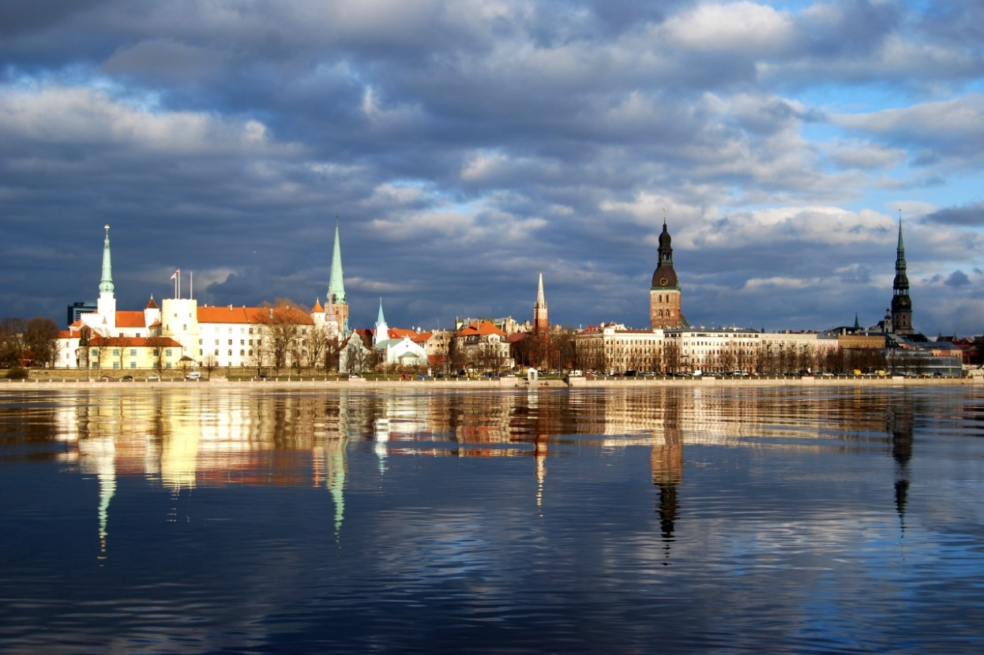
See you in Riga!
Save the date: 16-17th June, 2015
Thank you for your attention!
Zoltán Szatucsek
chair, DLM Forum Foundation
szatucsek.zoltan@mnl.gov.hu

